Slide 1
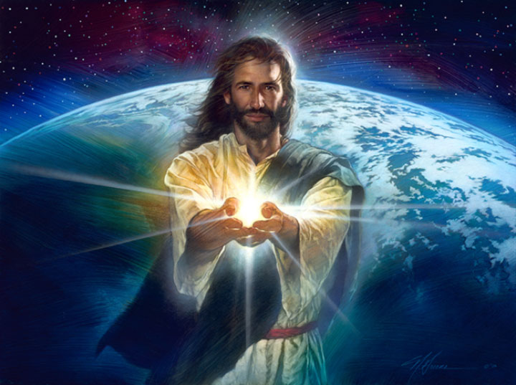
世界的光

Slide 2
約 8:12
耶穌又對眾人說：「我是世界的光。跟從我的，就不在黑暗裡走，必要得著生命的光。」
^{John 8:12}
When Jesus spoke again to the people, he said, “I am the light of the world. Whoever follows me will never walk in darkness, but will have the light of life.”

Slide 3
太5:13-20
「你們是世上的鹽。鹽若失了味，怎能叫他再鹹呢？以後無用，不過丟在外面，被人踐踏了。 (14) 你們是世上的光。城造在山上是不能隱藏的。 (15) 人點燈，不放在斗底下，是放在燈臺上，就照亮一家的人。 (16) 你們的光也當這樣照在人前，叫他們看見你們的好行為，便將榮耀歸給你們在天上的父。」

Slide 4
(17) 「莫想我來要廢掉律法和先知。我來不是要廢掉，乃是要成全。 (18) 我實在告訴你們，就是到天地都廢去了，律法的一點一畫也不能廢去，都要成全。 (19) 所以，無論何人廢掉這誡命中最小的一條，又教訓人這樣做，他在天國要稱為最小的。但無論何人遵行這誡命，又教訓人遵行，他在天國要稱為大的。 (20) 我告訴你們，你們的義若不勝於文士和法利賽人的義，斷不能進天國。」

Slide 5
Matthew 5:13-20
¹³ “You are the salt of the earth. But if the salt loses its saltiness, how can it be made salty again? It is no longer good for anything, except to be thrown out and trampled underfoot.
¹⁴ “You are the light of the world. A town built on a hill cannot be hidden. ¹⁵ Neither do people light a lamp and put it under a bowl.

Slide 6
Instead they put it on its stand, and it gives light to everyone in the house. ¹⁶ In the same way, let your light shine before others, that they may see your good deeds and glorify your Father in heaven.
The Fulfillment of the Law
¹⁷ “Do not think that I have come to abolish the Law or the Prophets;

Slide 7
I have not come to abolish them but to fulfill them. ¹⁸ For truly I tell you, until heaven and earth disappear, not the smallest letter, not the least stroke of a pen, will by any means disappear from the Law until everything is accomplished.

Slide 8
¹⁹ Therefore anyone who sets aside one of the least of these commands and teaches others accordingly will be called least in the kingdom of heaven, but whoever practices and teaches these commands will be called great in the kingdom of heaven.

Slide 9
²⁰ For I tell you that unless your righteousness surpasses that of the Pharisees and the teachers of the law, you will certainly not enter the kingdom of heaven.

Slide 10
使人看見神的光
The light that enable us to see God
約 12:45-46
人看見我，就是看見那差我來的。 (46) 我到世上來，乃是光，叫凡信我的，不住在黑暗裡。
John 12:45-46
⁴⁵ The one who looks at me is seeing the one who sent me. ⁴⁶ I have come into the world as a light, so that no one who believes in me should stay in darkness.

Slide 11
約14:6-9 耶穌說「我就是道路、真理、生命；若不藉著我，沒有人能到父那裡去。 (7) 你們若認識我，也就認識我的父。從今以後，你們認識他，並且已經看見他。」 (8) 腓力對他說：「求主將父顯給我們看，我們就知足了。」 (9) 耶穌對他說：「腓力，我與你們同在這樣長久，你還不認識我嗎？人看見了我，就是看見了父；你怎麼說『將父顯給我們看』呢？

Slide 12
John 14:6-9
⁶ Jesus answered, “I am the way and the truth and the life. No one comes to the Father except through me. ⁷ If you really know me, you will know my Father as well. From now on, you do know him and have seen him.”
⁸ Philip said, “Lord, show us the Father and that will be enough for us.”
⁹ Jesus answered: “Don’t you know me, Philip, even after I have been among you such a long time? Anyone who has seen me has seen the Father. How can you say, ‘Show us the Father’?

Slide 13
2. 使人看見生命的真理的光
The light that enable us to see the truth of life

Slide 14
3. 使人看見神恩惠的光
The light that enable us to see the grace of God

Slide 15
結語
你們是世界的光
Conclusion
You are the light of the world

